Slide 1


Group 4
Understanding and Classifying Statement Intention
Through detecting insincere questions on Quora platform
David CHONG Jian Wei
NEO Yi Peng
Nurul Aeiyuni Husna Binti BAKRI
LEE Meng Yong
ZHU Wanyi

Slide 2




Problem Statement
One of the greatest challenges existing in Natural Language Processing today is the understanding of intentions
Genuine?
Malicious?
Such malicious content can aggravate and even confuse readers
High penetration rate of social media
platforms allows content with malicious intention to
spread at an extremely fast rate
What and Why?

Slide 3
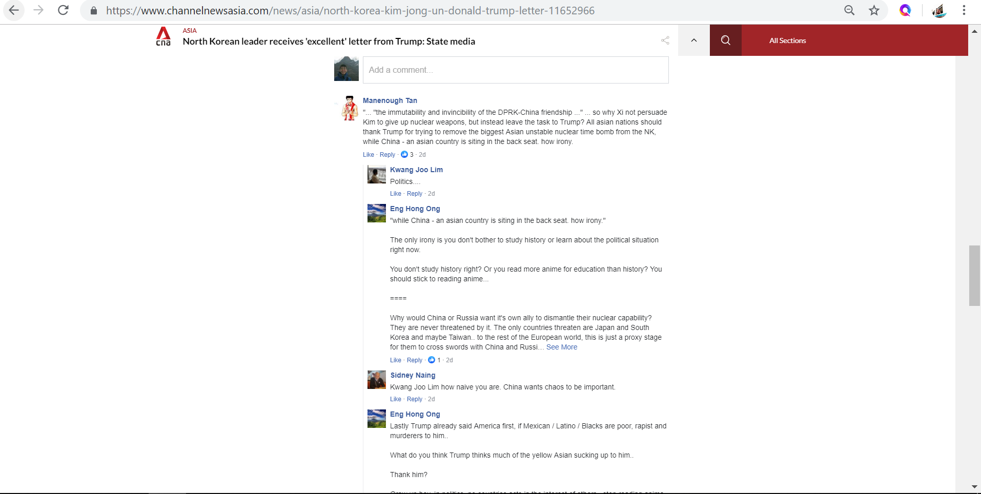
Troll
1. Fake Facebook Account
2. Polarising Statement
3. Rhetoric Question
4. Not Based on Ground Truth
Angry Users
Notes:
High penetration rate of social media platforms allows content with malicious intention to
spread at an extremely fast rate

Slide 4

Dataset: Detect Insincere Questions on
What is an Insincere Question?
A question that is not genuinely seeking answers.
Rhetorical questions
“Why won’t leftists finally understand how brilliant / intelligent President Trump is?”
Insulting questions
“Why are dark-skinned people so much less attractive than pale-skinned people?”
Questions that are not based on ground truth
“Why is it that European food is so terrible?”
Questions that use sexual content for shock value
“Which races have the smallest penis?”
4
Notes:
What is Quora?
An American question-and-answer platform with over 200 million monthly active users
376,000 rows

Slide 5

Why insincerity is hard to detect?
Understanding of the background information is often necessary.
North Korea
Insincere
Sincere
5

Slide 6

Dataset
Source of dataset - Kaggle Competition by Quora
Description of dataset
Over 1.3 millions of questions
A binary target label is given indicating if question is insincere
Training dataset is highly imbalanced (94% sincere questions v.s. 6% insincere questions)
6

Slide 7




Methodology
Text Pre-processing
Word Embedding
Classification Model
Model Evaluation
Punctuation removal
HTML tag removal
Tokenization
Stemming & Lemmatization
Spelling Correction
Convert text into vectors to reduce dimensionality
Naïve Bayes Classifier
Logistic Regression
Ensemble learning
Neural Network
F-score
Precision
Recall
Time complexity
7

Slide 8
Tools and Resources
Natural Language Processing packages in Python
- NLTK, spaCy, Gensim
Machine Learning and Deep Learning packages
Scikit Learn, TensorFlow, PyTorch, fast.ai
Word Embedding tools and datasets
- Word2vec, GloVe, fastText, Paragram Embeddings, Wiki News
8

Slide 9


Tools and Resources (2)
BERT (Bidirectional Encoder Representations from Transformers)
Word embeddings (word2vec, GloVe) are often pre-trained on text corpus from co-occurrence statistics
-> context free
BERT -> contextual representations
9

Slide 10

Q & A

